Slide 1
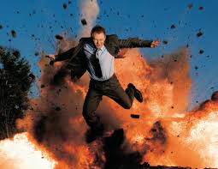
Answers: 1-5
1 Harriet: £0
2 Jhari: £1,200
3 Anamaria: £2,320
4 Phyllis: £4,152
5 Rocko: £4,551

Slide 2
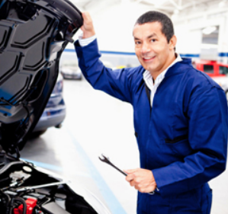
Answers: 6-10
6 Fred £2,920
7 Alice: £4,852
8 Eric: £5,500
9 Robert: £6,300
10 Faith: £7,344

Slide 3
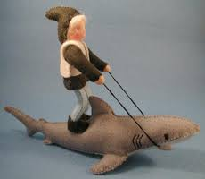
Answers: 11-15
11 Daiyu: £8,000
12 Maahir: £15,592
13 Shania: £39,350
14 Philip: £65,300
15 Astrid: £425,299

